Slide 1
Mehran S. Fallah June 2020
Discrete Mathematics
Session X
An Introduction to Logic

Slide 2







Introduction
We have introduced the propositional logic in the previous sessions. Here, is a recapitulation.
The set of all well-formed formulas (wff) of the propositional logic (statements or propositions) is defined to be the smallest set that is closed under the following rules.
$⊤$, $⊥$, and all sentence symbols are well-formed formulas.
If $α$ and $β$ are well-formed formulas, then so are $(¬α)$, $(α∧β)$, $(α∨β)$, and $\left(α⟶β\right).$
Given a truth assignment (model) $v:𝒜⟶\{0,1\}$, we define a valuation function $v^{∗}:𝒮⟶\{0,1\}$ that assigns a (correct) truth value to each well-formed formula $α∈𝒮$ of the language. For all $a∈𝒜$ and $α, β∈𝒮$,
A formula $α$ of the propositional logic is said to be a valid formula, or a tautology, if it is always true, that is, $v^{∗}\left(α\right)=1$ for all truth assignments $v$.
Two formulas $α$ and $β$ of the propositional logic are said to be logically equivalent, denoted $α⟺β$, if $α⟷β$ is a valid formula.
$$v^{∗}\left(a\right)=v\left(a\right).$$
$$v^{∗}\left(\left(¬α\right)\right)=1−v^{∗}\left(α\right).$$
$$v^{∗}\left(⊥\right)=0.$$
$$v^{∗}\left(α∧β\right)=v^{∗}\left(α\right)v^{∗}\left(β\right).$$
$$v^{∗}\left(⊤\right)=1.$$
$$v^{∗}\left(α∨β\right)=v^{∗}\left(α\right){+ v}^{∗}\left(β\right)−v^{∗}\left(α\right)v^{∗}\left(β\right).$$
$$v^{∗}\left(α⟶β\right)={1−v}^{∗}\left(α\right)\left(1−v^{∗}\left(β\right)\right).$$

Slide 3
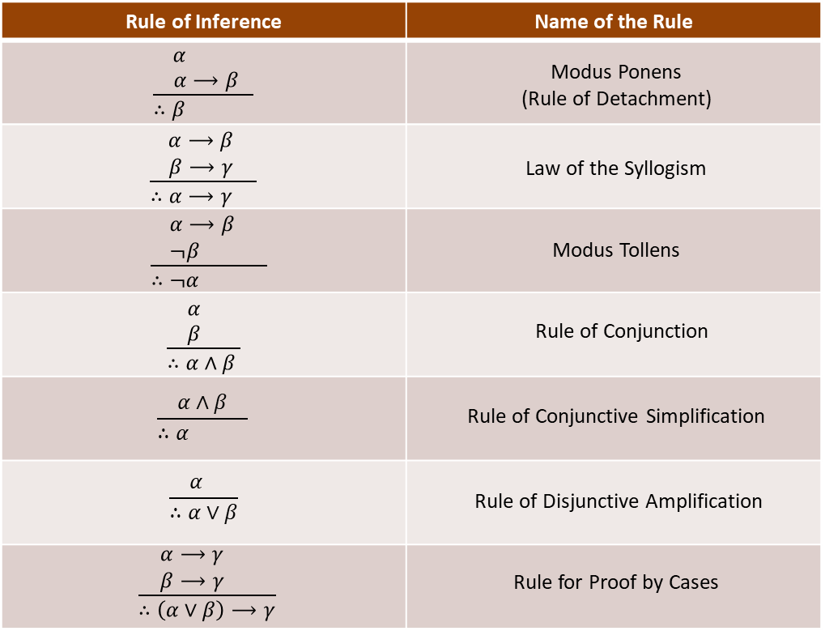

Introduction (Ctd.)
For two formulas $α$ and $β$, we say that $α$ logically implies $β$ and write $α⟹β$ if $α⟶β$ is a valid formula, i.e., a tautology.
Important logical implications that constitute our faculty of deduction are called rules of inference.
The following table lists a number of important rules of inference.

Slide 4
Introduction (Ctd.)
The logic introduced so far, i.e., the propositional logic, falls short of expressing, and reasoning about, the statements that we may face with in mathematics and, more importantly, in our daily lives.
Propositional logic does not give us the means to express a general principle that tells us that “if Alice is with her son on the beach, then her son is with Alice;” or “if someone is alone, they are not with someone else.”
How may one reason about the truth of the statement “If every person has a father, then Alice (who is a person) has a father” or “There exists a natural number that is less than or equal to all natural numbers?”
Indeed, we need a way to talk about objects and individuals, as well as their properties and the relationships between them. These are exactly what is provided by a more expressive logic known as first-order (predicate) logic.
First-order logic can be understood as an extension of the propositional logic. In propositional logic the atomic formulas have no internal structure—they are propositional variables that are either true or false.
In first-order logic, the atomic formulas are predicates that assert a relationship among certain elements. Another significant concept in first-order logic is quantification, the ability to assert that a certain property holds for all elements or for some element.

Slide 5
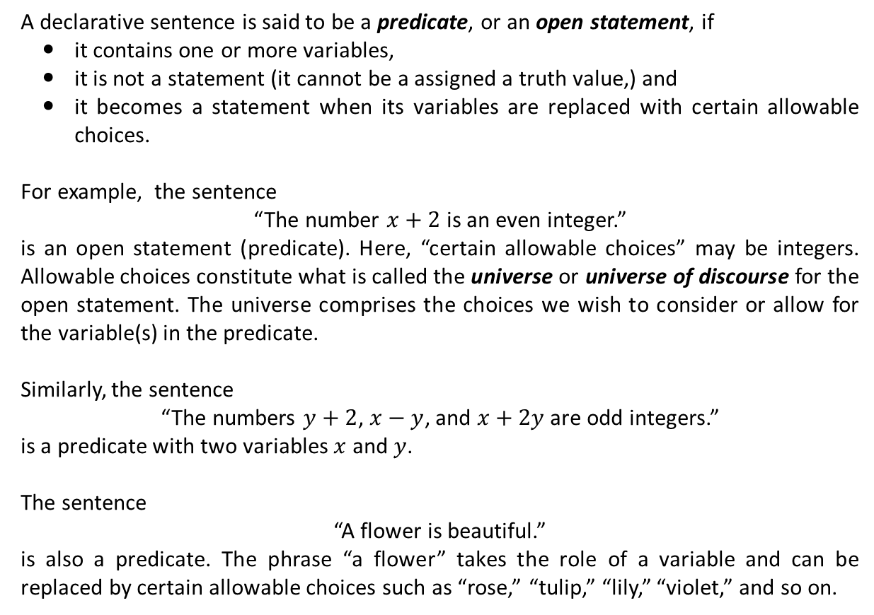

Open Statements (Predicates)
A declarative sentence is said to be a predicate, or an open statement, if
it contains one or more variables,
it is not a statement (it cannot be a assigned a truth value,) and
it becomes a statement when its variables are replaced with certain allowable choices.
For example, the sentence
“The number $x+2$ is an even integer.”
is an open statement (predicate). Here, “certain allowable choices” may be integers. Allowable choices constitute what is called the universe or universe of discourse for the open statement. The universe comprises the choices we wish to consider or allow for the variable(s) in the predicate.
Similarly, the sentence
“The numbers $y+2$, $x−y$, and $x+2y$ are odd integers.”
is a predicate with two variables $x$ and $y$.
The sentence
“A flower is beautiful.”
is also a predicate. The phrase “a flower” takes the role of a variable and can be replaced by certain allowable choices such as “rose,” “tulip,” “lily,” “violet,” and so on.
“$x$ is a beautiful flower.”

Slide 6

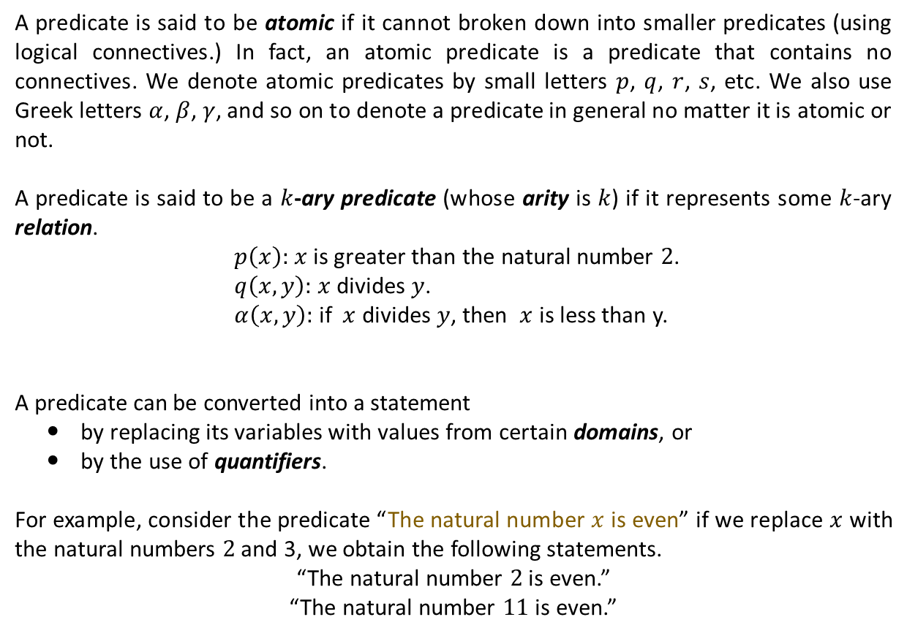


Predicates and Statements
A predicate is said to be atomic if it cannot broken down into smaller predicates (using logical connectives.) In fact, an atomic predicate is a predicate that contains no connectives. We denote atomic predicates by small letters $p$, $q$, $r$, $s$, etc. We also use Greek letters $α$, $β$, $γ$, and so on to denote a predicate in general no matter it is atomic or not.
A predicate is said to be a $k$-ary predicate (whose arity is $k$) if it represents some $k$-ary relation.
$p\left(x\right):$ $x$ is greater than the natural number $2$.
$q\left(x,y\right):$ $x$ divides $y$.
$α\left(x,y\right):$ if $x$ divides $y$, then $x$ is less than y.
A predicate can be converted into a statement
by replacing its variables with values from certain domains, or
by the use of quantifiers.
For example, consider the predicate “The natural number $x$ is even” if we replace $x$ with the natural numbers $2$ and 3, we obtain the following statements.
“The natural number $2$ is even.”
“The natural number $11$ is even.”
(unary)
(binary)
(binary)
$$q(x,y)$$
$$⟶$$
$$r(x,y)$$

Slide 7
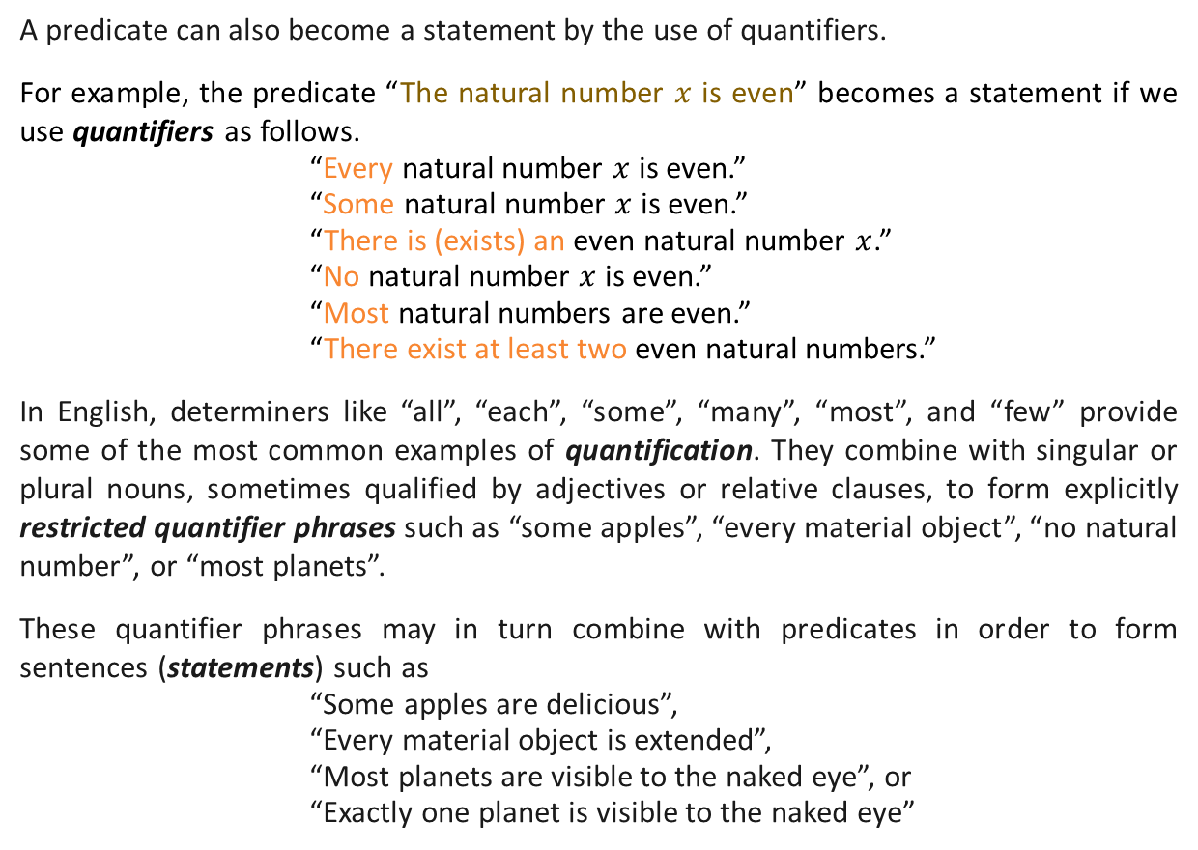
Predicates and Statements (Ctd.)
A predicate can also become a statement by the use of quantifiers.
For example, the predicate “The natural number $x$ is even” becomes a statement if we use quantifiers as follows.
“Every natural number $x$ is even.”
“Some natural number $x$ is even.”
“There is (exists) an even natural number $x$.”
“No natural number $x$ is even.”
“Most natural numbers are even.”
“There exist at least two even natural numbers.”
In English, determiners like “all”, “each”, “some”, “many”, “most”, and “few” provide some of the most common examples of quantification. They combine with singular or plural nouns, sometimes qualified by adjectives or relative clauses, to form explicitly restricted quantifier phrases such as “some apples”, “every material object”, “no natural number”, or “most planets”.
These quantifier phrases may in turn combine with predicates in order to form sentences (statements) such as
“Some apples are delicious”,
“Every material object is extended”,
“Most planets are visible to the naked eye”, or
“Exactly one planet is visible to the naked eye”

Slide 8
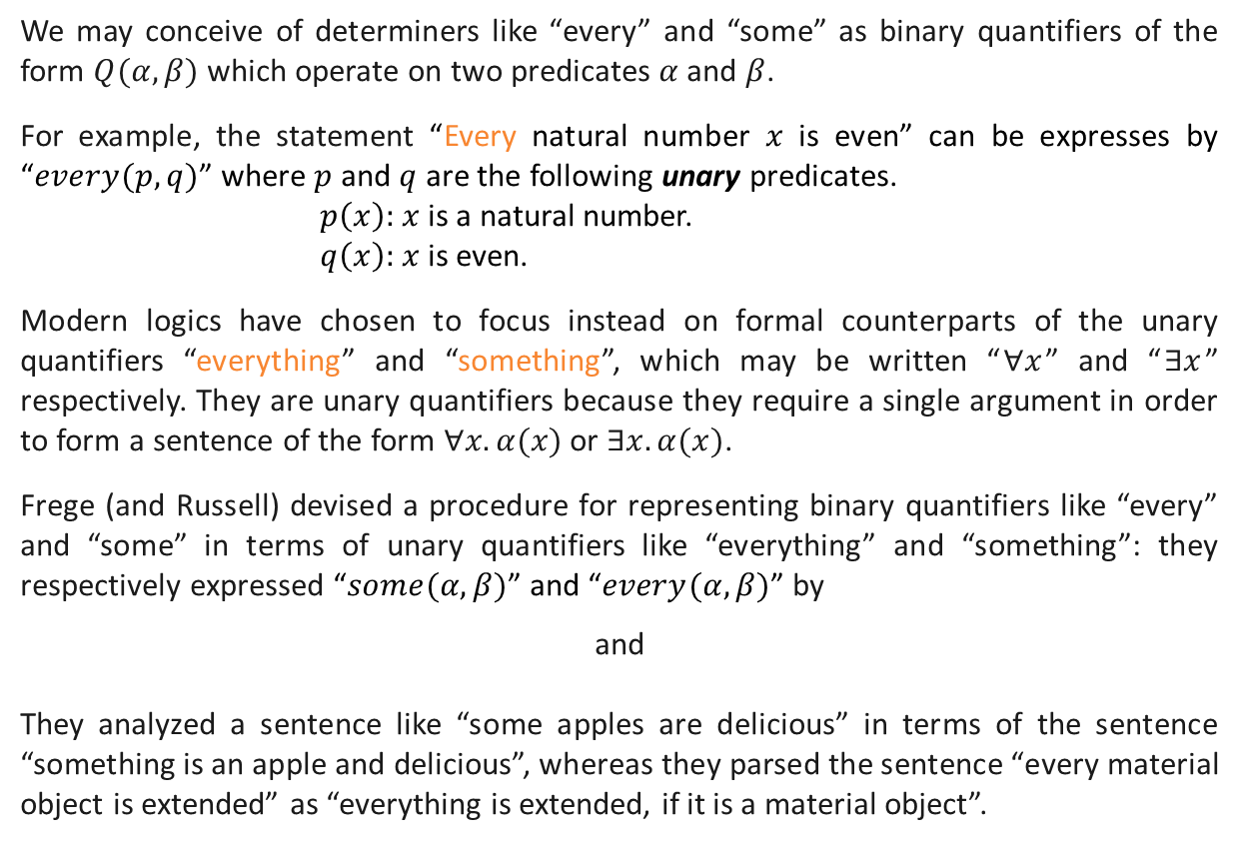


Predicates and Statements (Ctd.)
We may conceive of determiners like “every” and “some” as binary quantifiers of the form $Q(α,β)$ which operate on two predicates $α$ and $β$.
For example, the statement “Every natural number $x$ is even” can be expresses by “$every(p,q)$” where $p$ and $q$ are the following unary predicates.
$p\left(x\right):$ $x$ is a natural number.
$q\left(x\right):$ $x$ is even.
Modern logics have chosen to focus instead on formal counterparts of the unary quantifiers “everything” and “something”, which may be written “$∀x$” and “$∃x$” respectively. They are unary quantifiers because they require a single argument in order to form a sentence of the form $∀x. α(x)$ or $∃x. α(x)$.
Frege (and Russell) devised a procedure for representing binary quantifiers like “every” and “some” in terms of unary quantifiers like “everything” and “something”: they respectively expressed “$some(α,β)$” and “$every(α,β)$” by
and
They analyzed a sentence like “some apples are delicious” in terms of the sentence “something is an apple and delicious”, whereas they parsed the sentence “every material object is extended” as “everything is extended, if it is a material object”.
$$∃x. \left(α\left(x\right)∧β\left(x\right)\right)$$
$∀x. \left(α\left(x\right)⟶β\left(x\right)\right)$.

Slide 9
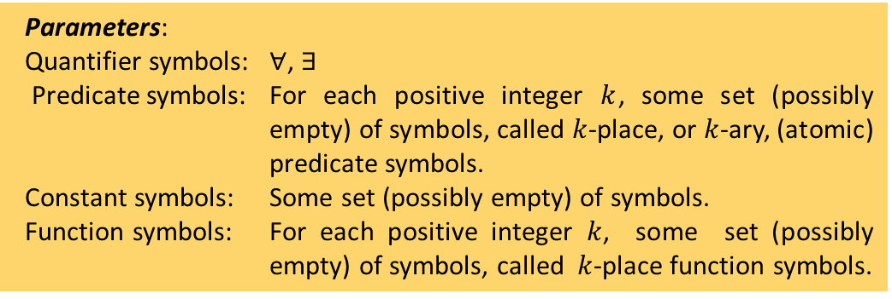
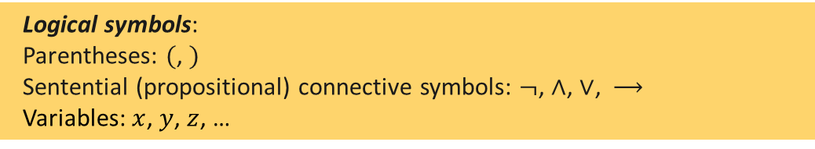
The Formal Language of FOL
As with the formal language of the propositional logic, we define a well-formed formula (wff) of first-order logic as a valid sequence of symbols, that is, a grammatically correct expression.
We assume that we have been given infinitely many distinct objects (which we call symbols), arranged as follows:
An expression is any finite sequence of symbols. Of course most expressions are nonsensical, but there are certain interesting expressions: the terms and the wffs.
Logical symbols:
Parentheses: $($, $)$
Sentential (propositional) connective symbols: $¬$, $∧$, $∨$, $⟶$
Variables: $x$, $y$, $z$, …
Universal (All, Every, Each, Any, For all $x$, For every $x$, …
Parameters:
Quantifier symbols: $∀$, $∃$
Predicate symbols: For each positive integer $k$, some set (possibly empty) of symbols, called $k$-place, or $k$-ary, (atomic) predicate symbols.
Constant symbols: Some set (possibly empty) of symbols.
Function symbols: For each positive integer $k$, some set (possibly empty) of symbols, called $k$-place function symbols.
Existential (Some, For some $x$, There is, There exists, …

Slide 10

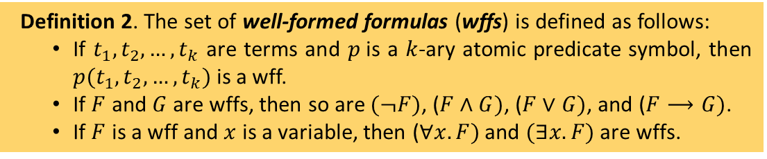
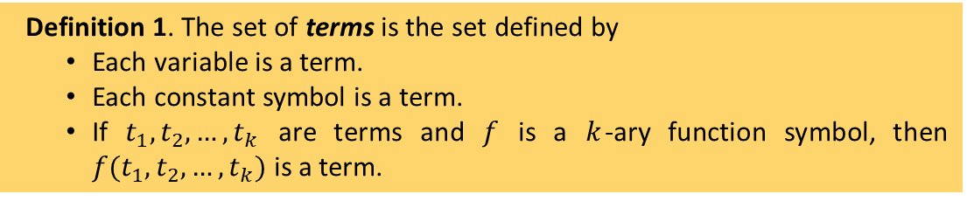
The Formal Language of FOL (Ctd.)
Example 1. Assume that there are only two unary atomic predicate symbols $p$, $q$ and only one binary function symbol $+$. Moreover, constant symbols are $0$ and 1. Write example terms and formulas of the language.
Solution. Example terms are
$0$, $1$, $x$, $y$, $+(x,1)$, $+(+(x,y),+(0, 1))$, $+(1,+(1,+(1,+(1, 0))))$.
Example wffs are
$\left(p\left(0\right)∧\left(¬p\left(x\right)\right)\right)$, $\left(\left(¬p\left(x\right)\right)∨\left(q\left(+\left(x, y\right)\right)⟶p\left(+\left(0,+\left(x, 1\right)\right)\right)\right)\right)$.
Definition 1. The set of terms is the set defined by
Each variable is a term.
Each constant symbol is a term.
If $t_{1}, t_{2}, …, t_{k}$ are terms and $f$ is a $k$-ary function symbol, then $f(t_{1}, t_{2}, …, t_{k})$ is a term.
Definition 2. The set of well-formed formulas (wffs) is defined as follows:
If $t_{1}, t_{2}, …, t_{k}$ are terms and $p$is a $k$-ary atomic predicate symbol, then $p(t_{1}, t_{2}, …, t_{k})$ is a wff.
If $F$ and $G$ are wffs, then so are $(¬F)$, ($F∧G)$, ($F∨G)$, and ($F⟶G)$.
If $F$ is a wff and $x$ is a variable, then ($∀x. F)$ and $(∃x.F)$ are wffs.

Slide 11
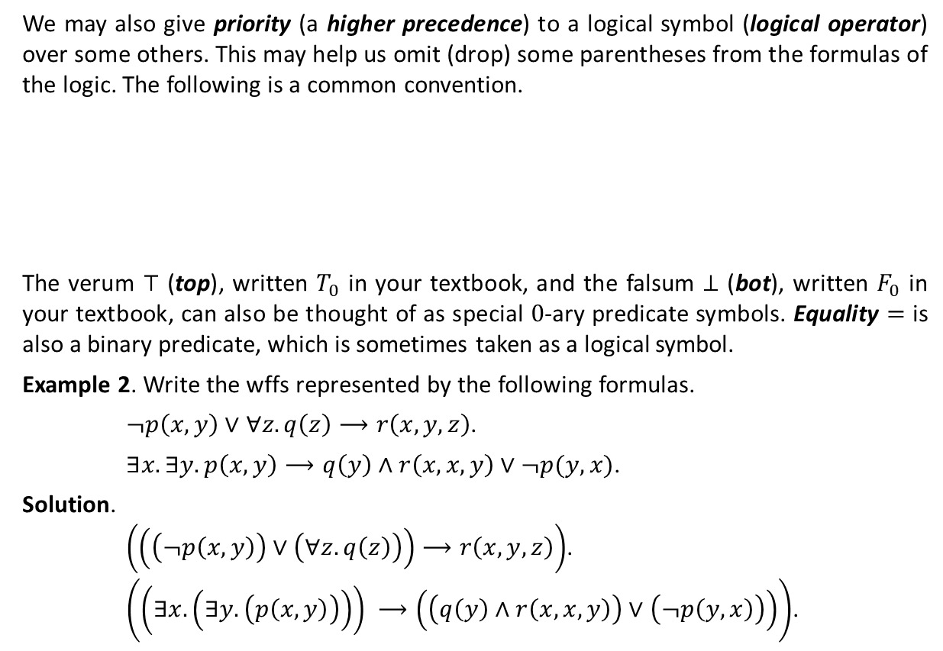
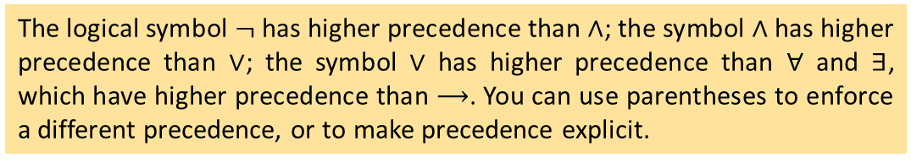
The Formal Language of FOL (Ctd.)
We may also give priority (a higher precedence) to a logical symbol (logical operator) over some others. This may help us omit (drop) some parentheses from the formulas of the logic. The following is a common convention.
The verum $⊤$ (top), written $T_{0}$ in your textbook, and the falsum $⊥$ (bot), written $F_{0}$ in your textbook, can also be thought of as special $0$-ary predicate symbols. Equality $=$ is also a binary predicate, which is sometimes taken as a logical symbol.
Example 2. Write the wffs represented by the following formulas.
$¬p\left(x,y\right)∨∀z. q\left(z\right)⟶r\left(x,y,z\right)$.
$∃x. ∃y. p\left(x,y\right)⟶q\left(y\right)∧r\left(x,x,y\right)∨¬p(y,x)$.
Solution.
$\left(\left(\left(¬p\left(x,y\right)\right)∨\left(∀z. q\left(z\right)\right)\right)⟶r\left(x,y,z\right)\right)$.
$\left(\left(∃x. \left(∃y. \left(p\left(x,y\right)\right)\right)\right) ⟶\left(\left(q\left(y\right)∧r\left(x,x,y\right)\right)∨\left(¬p\left(y,x\right)\right)\right)\right)$.
The logical symbol $¬$ has higher precedence than $∧$; the symbol ∧ has higher precedence than $∨$; the symbol $∨$ has higher precedence than $∀$ and $∃$, which have higher precedence than $⟶$. You can use parentheses to enforce a different precedence, or to make precedence explicit.

Slide 12
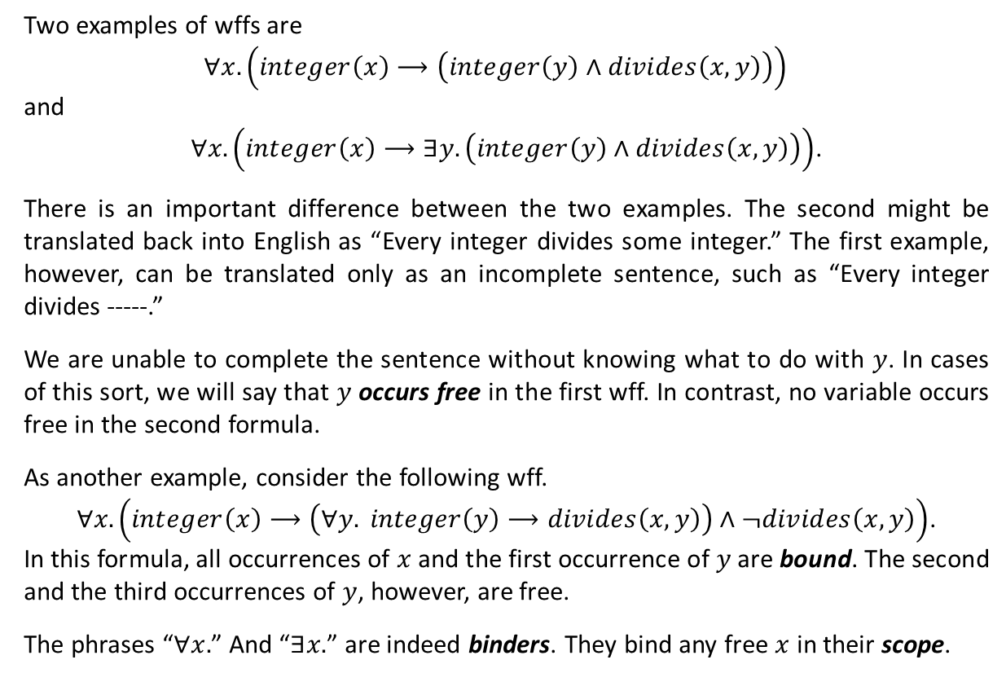
The Formal Language of FOL (Ctd.)
Two examples of wffs are
$$∀x. \left(integer\left(x\right)⟶\left(integer\left(y\right)∧divides\left(x,y\right)\right)\right)$$
and
$∀x. \left(integer\left(x\right)⟶∃y.\left(integer\left(y\right)∧divides\left(x,y\right)\right)\right)$.
There is an important difference between the two examples. The second might be translated back into English as “Every integer divides some integer.” The first example, however, can be translated only as an incomplete sentence, such as “Every integer divides -----.”
We are unable to complete the sentence without knowing what to do with $y$. In cases of this sort, we will say that $y$ occurs free in the first wff. In contrast, no variable occurs free in the second formula.
As another example, consider the following wff.
$∀x. \left(integer\left(x\right)⟶\left(∀y. integer\left(y\right)⟶divides\left(x,y\right)\right)∧¬divides\left(x,y\right)\right)$.
In this formula, all occurrences of $x$ and the first occurrence of $y$ are bound. The second and the third occurrences of $y$, however, are free.
The phrases “$∀x.$” And “$∃x.$” are indeed binders. They bind any free $x$ in their scope.

Slide 13
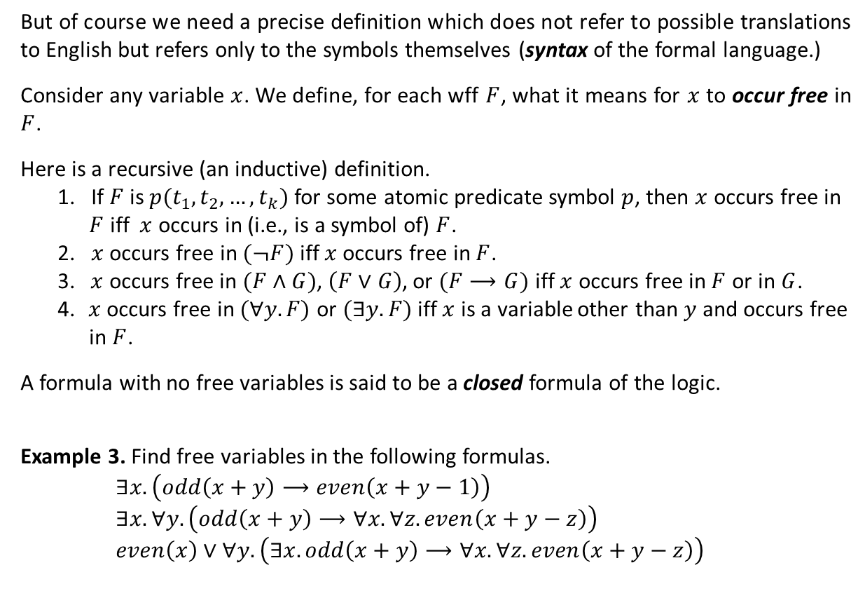
The Formal Language of FOL (Ctd.)
But of course we need a precise definition which does not refer to possible translations to English but refers only to the symbols themselves (syntax of the formal language.)
Consider any variable $x$. We define, for each wff $F$, what it means for $x$ to occur free in $F$.
Here is a recursive (an inductive) definition.
1. If $F$ is $p(t_{1},t_{2}, …,t_{k})$ for some atomic predicate symbol $p$, then $x$ occurs free in
$F$ iff $x$ occurs in (i.e., is a symbol of) $F$.
2. $x$ occurs free in $(¬F)$ iff $x$ occurs free in $F$.
3. $x$ occurs free in $(F∧G)$, $\left(F∨G\right)$, or $(F⟶G)$ iff $x$ occurs free in $F$ or in $G$.
4. $x$ occurs free in $(∀y.F)$ or $(∃y.F)$ iff $x$ is a variable other than $y$ and occurs free
in $F$.
A formula with no free variables is said to be a closed formula of the logic.
Example 3. Find free variables in the following formulas.
$∃x. \left(odd\left(x+y\right)⟶even\left(x+y−1\right)\right)$
$∃x. ∀y. \left(odd\left(x+y\right)⟶∀x. ∀z.even\left(x+y−z\right)\right)$
$even\left(x\right)∨∀y. \left(∃x. odd\left(x+y\right)⟶∀x. ∀z.even\left(x+y−z\right)\right)$
free
closed formula

Slide 14
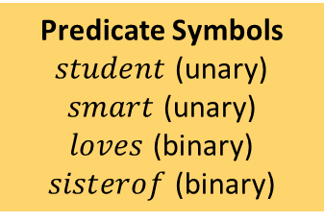

Translation into the Formal Language
Given a set of sentences of a natural language, one may decide on sets of constants, variables, function and predicate symbols (and their arities.) These collectively make the signature of the first-order logic. It is worth noting that we may not explicitly mention the signature if it is known from the context.
By deciding on an appropriate signature, one can translate the sentences of a natural language into the formal language of the first-order logic.
As an example, we translate the following English sentences into the formal language of a first-order logic.
There exists a student.
All students are smart.
There exists a smart student.
Every student loves some student.
Every student loves some other student.
There is a student who is loved by every other student.
Bill is a student.
No student loves Bill.
Bill has no sister.
Bill has exactly one sister.
Constant symbols
$$Bill$$
Predicate Symbols
$student$ (unary)
$smart$ (unary)
$loves$ (binary)
$sisterof$ (binary)
Function Symbols
No symbol

Slide 15

Translation into the Formal Language (Ctd.)
English | Translation
There exists a student.
$$∃x. student(x)$$
All students are smart.
$$∀x. \left(student\left(x\right)⟶smart\left(x\right)\right)$$
There exists a smart student.
$$∃x. \left(student\left(x\right)∧smart\left(x\right)\right)$$
Every student loves some student.
$$∀x. \left(student\left(x\right)⟶∃y. \left(student\left(y\right)∧loves\left(x,y\right)\right)\right)$$
Every student loves some other student.
$$∀x. \left(student\left(x\right)⟶∃y. \left(student\left(y\right)∧y≠x∧loves\left(x,y\right)\right)\right)$$
There is a student who is
loved by every other student.
$$∃x. \left(student\left(x\right)∧∀y.\left(\left(student\left(y\right)∧y≠x\right)⟶loves\left(y,x\right)\right)\right)$$
Bill is a student.
$$student(Bill)$$
$$∀x. \left(student\left(x\right)⟶¬loves\left(x,Bill\right)\right)$$
No student loves Bill.
$$\text{or}$$
$$¬∃x. \left(student\left(x\right)∧loves\left(x,Bill\right)\right)$$
$$∀x. ¬sisterof(x,Bill)$$
Bill has no sister.
$$\text{or}$$
$$¬∃x. sisterof(x,Bill)$$
$$∃x. \left(sisterof\left(x,Bill\right)∧∀y. \left(y≠x⟶¬sisterof\left(y,Bill\right)\right)\right)$$
Bill has exactly one sister.
$$\text{or}$$
$$∃x.sisterof\left(x,Bill\right)$$
$$∧∀x. ∀y.\left(\left(sisterof\left(x,Bill\right)∧sisterof\left(y,Bill\right)\right)⟶y=x\right)$$

Slide 16
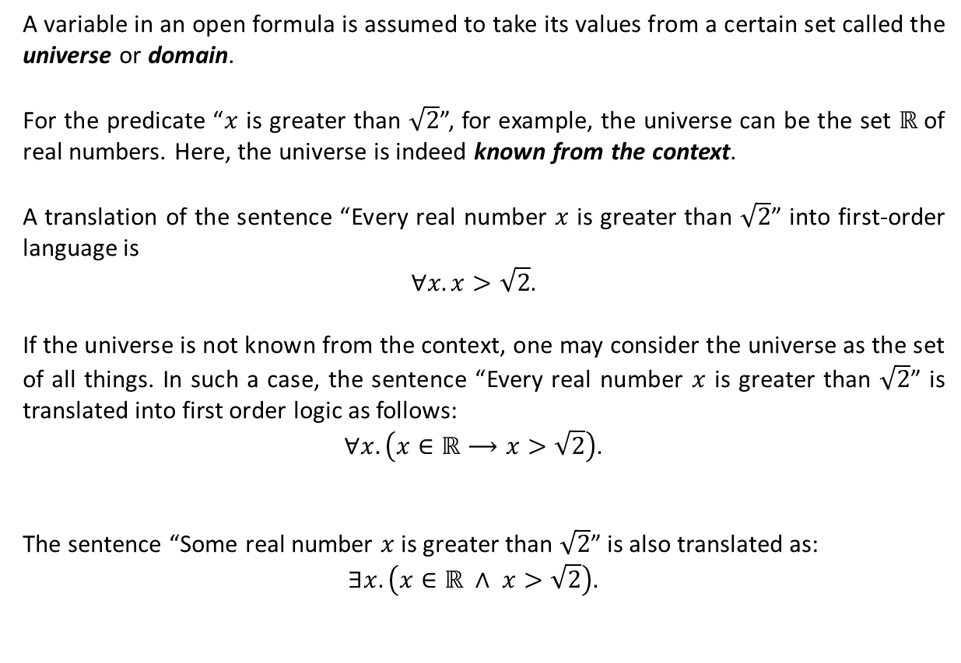


A Note on the Universe for Predicates
A variable in an open formula is assumed to take its values from a certain set called the universe or domain.
For the predicate “$x$ is greater than $\sqrt{2}$”, for example, the universe can be the set $ℝ$of real numbers. Here, the universe is indeed known from the context.
A translation of the sentence “Every real number $x$ is greater than $\sqrt{2}$” into first-order language is
$$∀x. x>\sqrt{2}.$$
If the universe is not known from the context, one may consider the universe as the set of all things. In such a case, the sentence “Every real number $x$ is greater than $\sqrt{2}$” is translated into first order logic as follows:
$$∀x. \left(x∈ℝ⟶x>\sqrt{2}\right).$$
The sentence “Some real number $x$ is greater than $\sqrt{2}$” is also translated as:
$$∃x. \left(x∈ℝ ∧ x>\sqrt{2}\right).$$
$$∀x∈ℝ. x>\sqrt{2}.$$
$$∃x∈ℝ. x>\sqrt{2}.$$

Slide 17
Textbook: Ralph P. Grimaldi, Discrete and Combinatorial Mathematics
Do exercises of Chapter 2 as homework and upload your solutions via Moodle (follow the instructions on the page of the TA of this course.)

